Slide 1
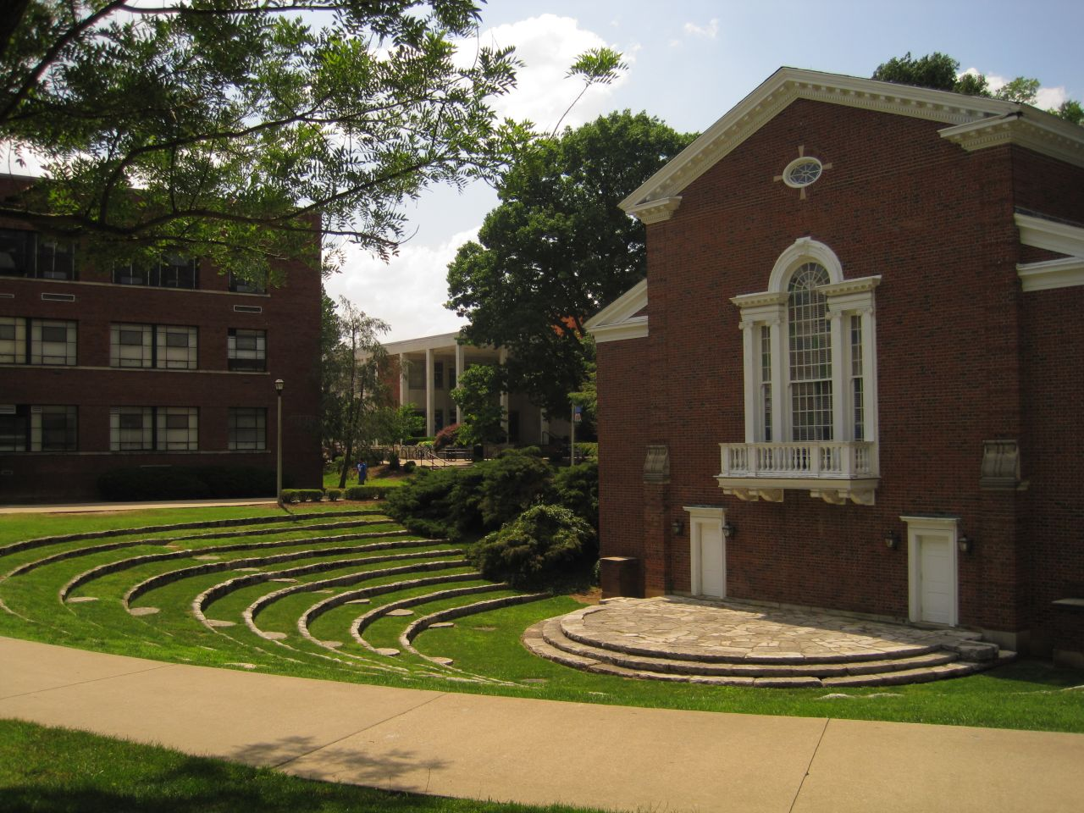
UNIVERSITY OF KENTUCKY
KIRWAN BLANDING
G:\26143.00\Kirwan Blanding 201409\Rendering Deliverables\2017_10_20_Kirwan Blanding_renderings.pptx
Notes:
Original Image path: C:\Users\ghavens\Documents\UKentucky\site photos\IMG_3752.JPG
Original Size: 2.9MB W:3,648px H:2,736px
Compressed Size: 240KB W:1,280px H:960px (91.9% using JPEG compression of 80)
Last Updated: 5/30/2012 3:59:44 PM by ghavens via Sasaki PPT Image Manager

Slide 2
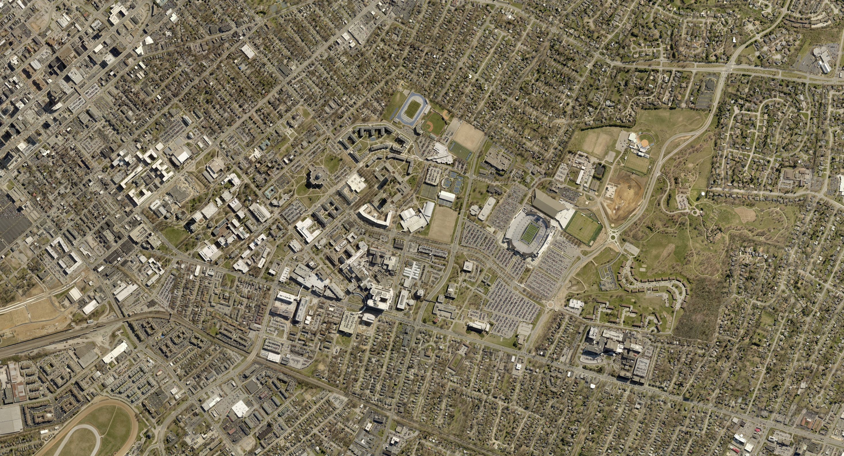
Existing Conditions
Library
Notes:
Original Image path: G:\26143.00\REVISED_ILLUSTRATIVE_07-2017\GIS\Data\Aerial\Aerial_2017_05ftres.jpg
Last Updated: 10/13/2017 10:21:45 AM by ghavens via Sasaki PPT Image Manager

Slide 3
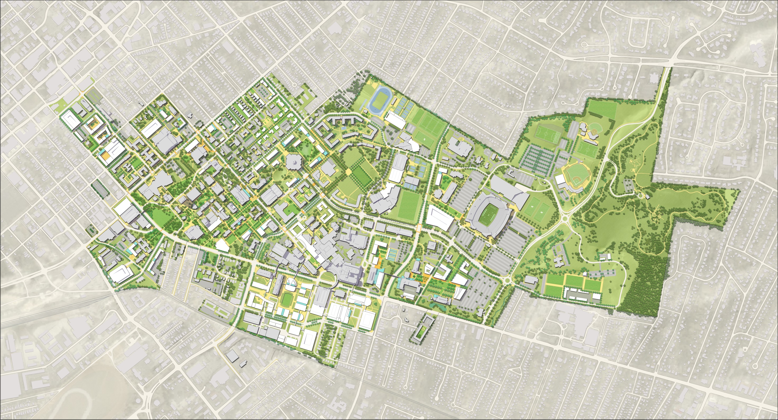
Kirwan-Blanding After Demolition – Future Green
Notes:
Original Image path: G:\26143.00\REVISED_ILLUSTRATIVE_07-2017\Transmit\DESIGN DISTILL RENDERING MATERIAL\PHASE ONE_LAWN\2017-10-11 - UK - KIRWAN UPDATE_LAWN.jpg
Original Size: 3.2MB
No compression. WARNING: this is a large image, please consider optimizing.
Last Updated: 10/12/2017 2:28:17 PM by sliu via Sasaki PPT Image Manager

Slide 4
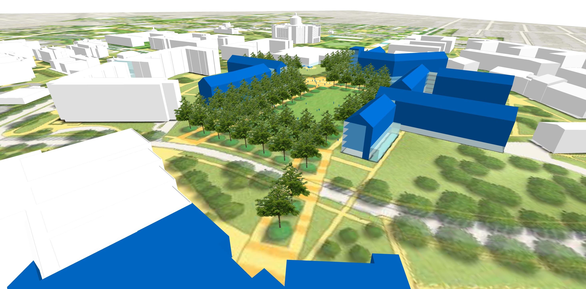
Green with Future Building Sites
Library
Notes:
Original Image path: G:\26143.00\REVISED_ILLUSTRATIVE_07-2017\Transmit\DESIGN DISTILL RENDERING MATERIAL\PHASE TWO_PROPOSED BLDGS +LAWN\BIRDEYE BLDGS+LAWN.jpg
Original Size: 2.7MB
No compression. WARNING: this is a large image, please consider optimizing.
Last Updated: 10/20/2017 8:43:59 AM by ghavens via Sasaki PPT Image Manager

Slide 5
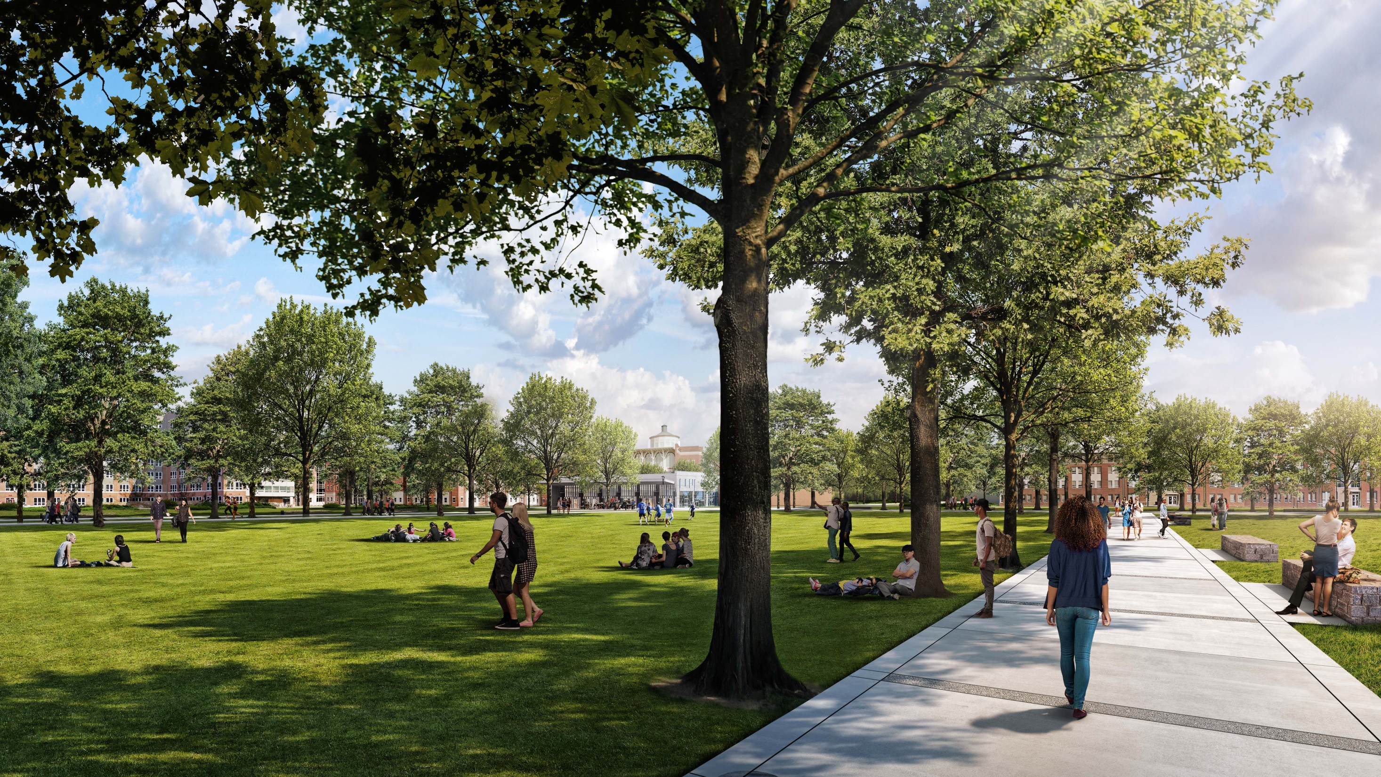
Concept: Future Allee with Green
Notes:
Original Image path: G:\26143.00\Kirwan Blanding 201409\Rendering Deliverables\DD_Sasaki_Kentucky_View01_WithOutBuildings_2017_10_19 Preview (1).jpg
Original Size: 2.7MB
No compression. WARNING: this is a large image, please consider optimizing.
Last Updated: 10/20/2017 8:45:04 AM by ghavens via Sasaki PPT Image Manager

